Slide 1

The Digital Divide:
Understanding & Bridging the Gap
Created by: Ryan Benham
What you'll learn:
• What the digital divide is and who it affects
• Key factors: income, age, race, education, disability
• Local context: Riverside County
• Strategies educators can use right now

Slide 2

ESSENTIAL QUESTIONS
01
How do we define the Digital Divide?
02
What factors drive it?
03
How does it affect our own community?
04
How can educators work to close it?

Slide 3
What Is the
Digital Divide?
Section 1 — Definitions & scope

Slide 4


Intro: The Digital Divide
A global gap
🌐
Differences in tech use within and between countries.
Growing but unequal
📈
Internet use has surged — but inequity persists.
“The gap between those
who have access to
technology and those
who do not.”
More than access
💡
It includes quality of access, digital skills, and ability to benefit.
— Huffman, 2018

Slide 5
What Drives
the Divide?
Section 2 — Income · Age · Race · Education · Disability

Slide 6

Factor 1: Income
46%
4%
10×
of poorest households
have no computer
of wealthiest households
have no computer
more likely to lack
a computer if low-income
Internet Access by Household Income
Under $30K
79%
$30K–$74K
93%
$75K+
98%
Source: Huffman (2018); Pew Research

Slide 7

Factor 2: Age & Geography
AGE
GLOBAL INTERNET USERS
% using the internet, by age group
Share of global internet users, 2017
18–29
96%
Asia
50%
30–49
93%
Europe
17%
Lat Am
10%
50–64
83%
Africa
9%
65+
64%
N. America
9%
In 2016, only 64% of adults 65+ used the internet. (Huffman, 2018)
Middle East
4%
Reflect: How might age-related internet gaps affect parent-teacher communication in your school?
Source: Internet World Stats, 2017

Slide 8

Factor 3: Education & Disability
EDUCATION LEVEL
DISABILITY
% who use the internet, by education
% using the internet
College grad
98%
78.5%
Some college
91%
without disability
High school
78%
59.2%
No HS degree
68%
with disability
19-point gap. Source: Statistica, 2019
30-pt gap between most and least educated. (Huffman, 2018)
Reflect: Which of these groups are present in your classroom or district? What does that mean for your course design?

Slide 9
Local Case Study:
Riverside County
Section 3 — The divide in our own community

Slide 10

Riverside County: By the Numbers
2.4M
51.6%
90.8%
residents
Latino or Hispanic
households have internet
9.2%
95.4%
23.5%
households have NO internet
households have a computer
hold a bachelor's degree+
Source: US Census Bureau, 2020

Slide 11
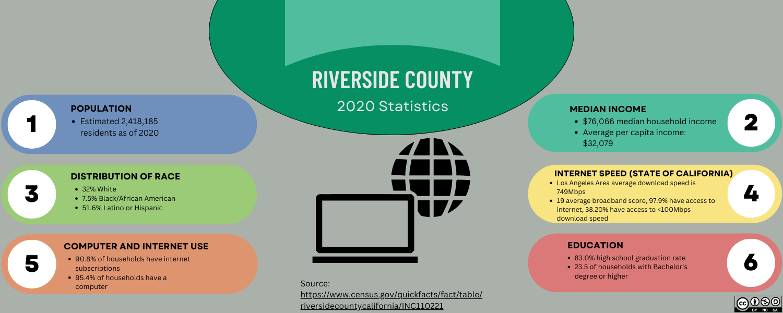
What Does This Mean for RUSD Students?
9.2% of households have no internet — that's ~220,000 people in this county alone.
📶
Only 1 in 4 residents holds a bachelor's degree, compounding the digital literacy gap.
🎓
Over half the population is Latino/Hispanic — a group disproportionately affected nationally.
👩‍👧
Reflect: Which of these stats surprises you most? What could your school do about it?

Slide 12
Closing
the Divide
Section 4 — Programs, policies & educator strategies

Slide 13

Ways Educators Can Close the Divide
1
2
💻 Loaner Devices
📡 Affordable Internet
Districts provide laptops so every student has a device at home.
A4AI & local ISPs drive down costs to make broadband accessible.
3
4
📖 Digital Literacy
🏠 "A Place Called Home"
Age- and skill-targeted training that adapts as technology changes.
LA-area program that has raised grades for students with no home internet.

Slide 14

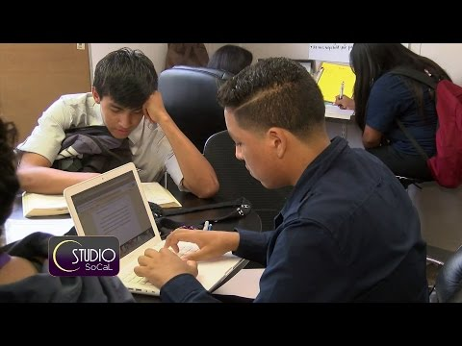
Video: Helping Students Combat the Digital Divide
▶
Click thumbnail to watch • youtube.com/watch?v=8KSkWalmV1s
As you watch: What barriers do these students face, and what solutions are proposed?

Slide 15

Knowledge Check & Reflection
Before moving on, test your understanding:
1
Which income group is more than 10× less likely to own a computer?
2
What percentage of adults 65+ used the internet in 2016?
3
Name one program or initiative working to close the digital divide.
4
How does limited home broadband directly affect student learning?
These questions map to the module's essential questions on slide 2.

Slide 16

Sources & References
1. US Census Bureau (2020). Riverside County Quick Facts. census.gov/quickfacts/fact/table/riversidecountycalifornia
2. Pew Research Center (2017). Internet use by education. pewresearch.org/internet/chart/internet-use-by-education/
3. Statistica (2022). Internet access by disability status, Nov. 2019.
statista.com/statistics/368609
4. Vogels, E. (2021). Digital divide persists even as lower-income Americans make gains. Pew Research Center.
5. Huffman, S. (2018). The digital divide revisited: What's next? Education, 3rd Ed., Vol. 138.
6. Alliance for Affordable Internet.
a4ai.org/
7. Nazar, D. (2015). Education: Helping Students Combat the Digital Divide. YouTube. youtube.com/watch?v=8KSkWalmV1s

